Slide 1

Video Fingerprinting Project
１１/２００９

Slide 2
Video Fingerprint Project
Overview:
  What is Video Fingerprinting
  What can be done
  How it is done
    Database, algorithm
  Preliminary results
  Related work

Slide 3
Video Fingerprint Project
Video Fingerprinting is:
  A way to tie a video, or a segment of it, to a unique key.
  Useful when searching for specific content.
  Advantage in Content related companies.

Slide 4
Video Fingerprint Project
Information inside videos:
  Luminance
    Intensity of light
  Chroma
    Color
  Time
    Sense of movement

Slide 5
Video Fingerprint Project
What to expect:
  Solution must be accurate
    Detect scenes after various video manipulations
  Solution must be fast
    Find the clip among many other videos
  Solution must use low memory
    Efficiently index the results in a database

Slide 6
Video Fingerprint Project
What can be done:
  Detect videos with different resolutions
    (FullHD to VGA)
  Diff framerate (60fps to 15fps)
  Subtitles (0pt to 40pt)
  Different brightness/contrast/gamma
    (videos are normalized)
  Out of order clips
  Several appearances of clip in larger videos

Slide 7
Video Fingerprint Project
How we do it (Database):
  Analysis of video properties:
    Luma and Chroma values show prolonged, near equal, values that can be indexed to an interval.
  Storage efficiency:
    Using the previous indexes to store only big differences we can save from 20% to 60% of DB space.
  Look-Up Tables:
    By mapping which Luma and Chroma values those indexes have, in a table, the search process is faster.

Slide 8
Video Fingerprint Project
How we do it (Algorithm):
  Hierarchical approach.
    1)Look-Up Table of Luma and Chroma
    2)Distance of indexes
    3 and 4) Tanimoto Correlation and Vector Distance.
  Look-up is fast and can easily discard obvious different movies. It also scales well.
  Distance of indexes is quite efficient.
    Only 10% of movies are analyzed with Tanimoto Correlation and Vector Distance.

Slide 9
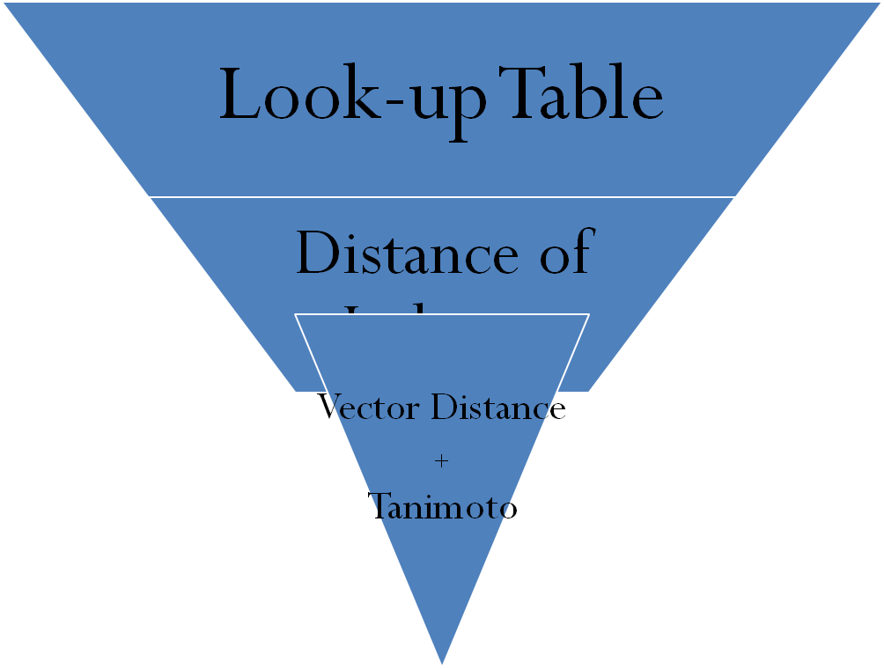
Video Fingerprint Project
Hierarchy structure:

Slide 10
Video Fingerprint Project
How we do it (Algorithm, continued):
  Every movie has its indexes extracted
  Luma and Chroma of indexes is stored in LUT
    Average Luma and length of index
  Each movie has three tables
    Luma, ChromaU and Chroma V, all with start of indexes
  When analyzing Movie against a Clip:
    Check what movies have the same Luma indexed in LUT
    Analyze which movies have an index of the same length
    Only those who passed 1 and 2 will be matched by Distance of Indexes
    Those who passed 3 will be scored by Tanimoto and Distance of Vectors

Slide 11

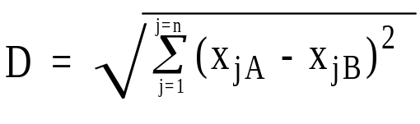
Video Fingerprint Project
How we do it (Algorithm, continued):
  Tanimoto
    Tanimoto makes a correlation with C and the remaining elements outside C
  Vector distance
B
A
C

Slide 12
Video Fingerprint Project
How we tested:
  Downloaded 210 videos from youtube.com
    Average length of 6 minutes, diverse selection
  Each movie compared with all remaining 209 movies
  After 210*210 comparisons:
    3 False Negatives
    6~80 False Positives
    Lowest Avg. of 11 seconds search for each 209 comparisons

Slide 13
Video Fingerprint Project
Table of resources and efficiency:
Prelem is the pre-elimination factor, separating steps 1 and 2 from the computationally heavy steps 3 and 4.
The prelem factor is the diameter of Luma values that are searched for, when matching Luma interval distances.
FN and FP are the number of False Negatives and Positives
 | Threshold of 0.1 |  |  | Threshold of 0.05 |  |  | Threshold of 0.025 |  |  | Threshold of 0.01 |  |  | Threshold of 0.005
 | DB Size | 1234 | Kb | DB Size | 1434 | Kb | DB Size | 1656 | Kb | DB Size | 1971 | Kb | DB Size | 2297 | Kb
Prelem | Runtime | FP | FN | Runtime | FP | FN | Runtime | FP | FN | Runtime | FP | FN | Runtime | FP | FN
0.05 | 22.46 | 72 | 9 | 16.76 | 40 | 8 | 12.64 | 54 | 8 | 10.7 | 6 | 5 | 11.49 | 19 | 3
0.2 | 27.32 | 79 | 5 | 22.36 | 47 | 6 | 16.92 | 56 | 7 | 12.59 | 14 | 5 | 12.31 | 20 | 3
0.3 | 29.52 | 82 | 5 | 25.88 | 49 | 3 | 20.96 | 60 | 7 | 15.03 | 16 | 4 | 14.17 | 27 | 3
0.4 | 31.54 | 84 | 4 | 29.22 | 51 | 3 | 25.31 | 64 | 3 | 18.67 | 17 | 4 | 16.97 | 33 | 3

Slide 14
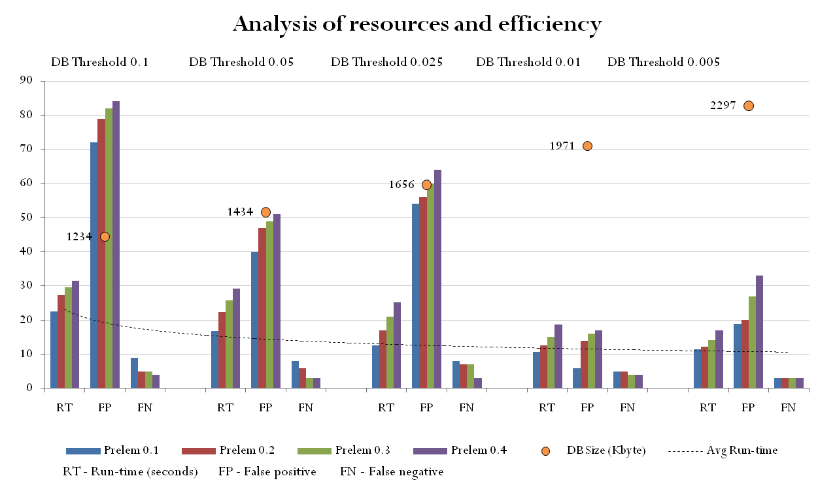
Video Fingerprint Project

Slide 15
Video Fingerprint Project
Related work:
  Model of threshold calculations
  Study of False-Positives vs. False-Negatives
      Confirms the values also found by us
  Extensive tests
  Ideas that still need to be tested by us
    Divide frame into NxM parts (implemented, not tested)

Slide 16
Video Fingerprint Project
Related work:
  Large initial overhead
    Movies are encoded from any size (even FullHD) to QVGA size “in order to improve accuracy”
  Large fingerprints
    They have each frame divided into S sectors (each frame has in reality S fingerprints, one for each sector)
    KAIST concatenates K*S fingerprints from K frames
  Non-existent DB schemes
    “Arrays in memory” and “554,197,443 pairs of fingerprints”

Slide 17
Video Fingerprint Project
What we have:
  Scalable solution
  Smaller initial overhead
    Movies are only read for Luma, ChromaU/V extraction
  Smaller fingerprints
    Each second has one fingerprint of 2³ bytes
  A real DB scheme and efficient indexing
    Hierarchical searches, data similarity clustering and look-up tables

Slide 18
Video Fingerprint Project
What we also have:
  No information on how fast their process is
  More ideas to improve results
    Improvements of static/image videos
    Multi-threading, Clustering
  Real world projects to test and improve our solution

Slide 19
Video Fingerprint Project
Next steps:
  Comparison with KAIST’s Centroid of Gradient Orientations (C.G.O.)_{[1]}
  Test with a higher number of videos
  Test other relevant aspects
    Blurring of videos, rotation
  Apply in real world application
  Include audio fingerprinting
[1] S. Lee, C.D. Yoo “Robust Video Fingerprinting for Content-Based Video
Identification”, IEEE Trans. Circuits and Systems for Video Technology, Jul 2008

Slide 20
Video Fingerprint Project
Thank you

